Slide 1
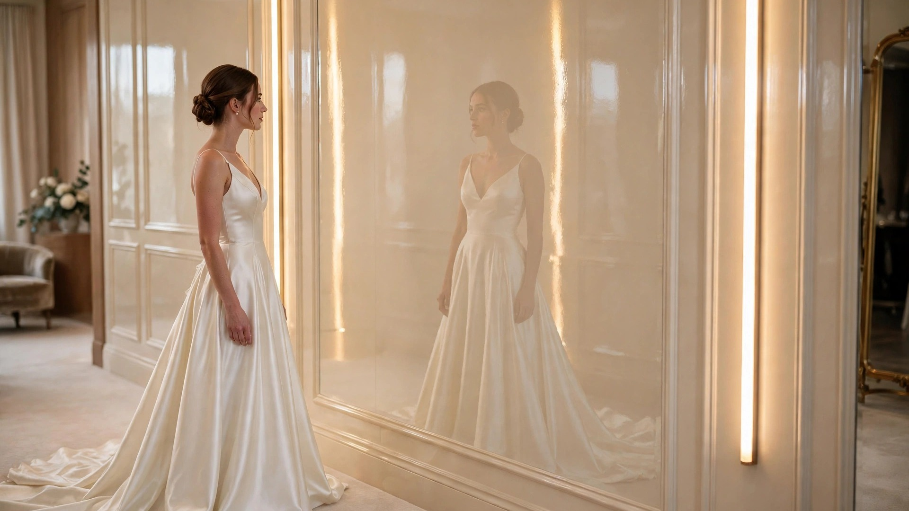
GREATLAKES PAINTING & RENOVATION
THE ART OF THE BRIDAL FITTING ROOM
The Moment She Finds The Dress.
Imagine the experience inside a fitting room designed to make every detail feel extraordinary.
CONCEPTUAL VISUALIZATION

Slide 2
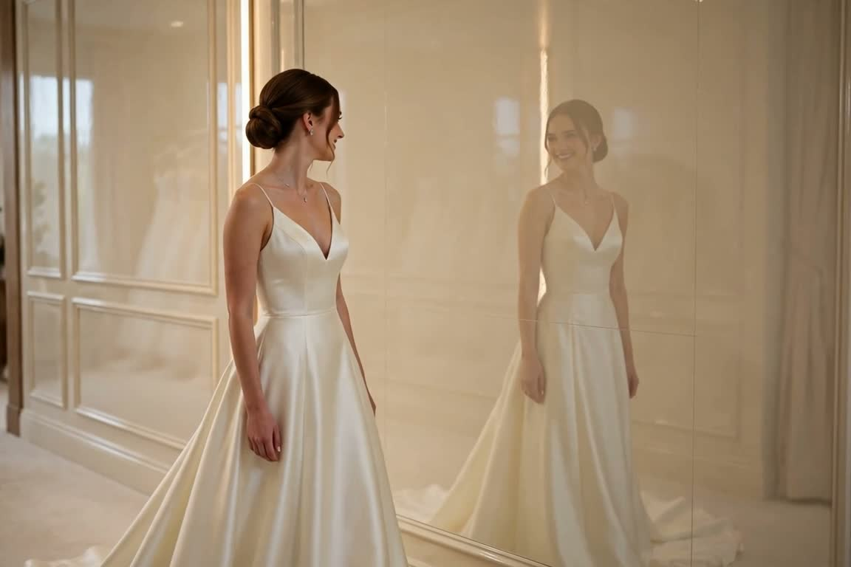
02 · THE EXPERIENCE
A Fitting Room Can Be More Than A Fitting Room.
The fitting room is where a bride spends the most personal part of her visit — alone with the dress, deciding how it makes her feel.
A thoughtfully designed interior changes that moment: beautiful light, a distinctive finish, and her gown reflected in the wall itself.
Not a bigger mirror. A room that makes the dress — and the day she chose it — feel unforgettable.
▶ THE CONCEPT FILM Ivory Mirror-Gloss Fitting Rooms · 0:17 · tap to play
GREATLAKES PAINTING & RENOVATION
Conceptual Visualization

Slide 3
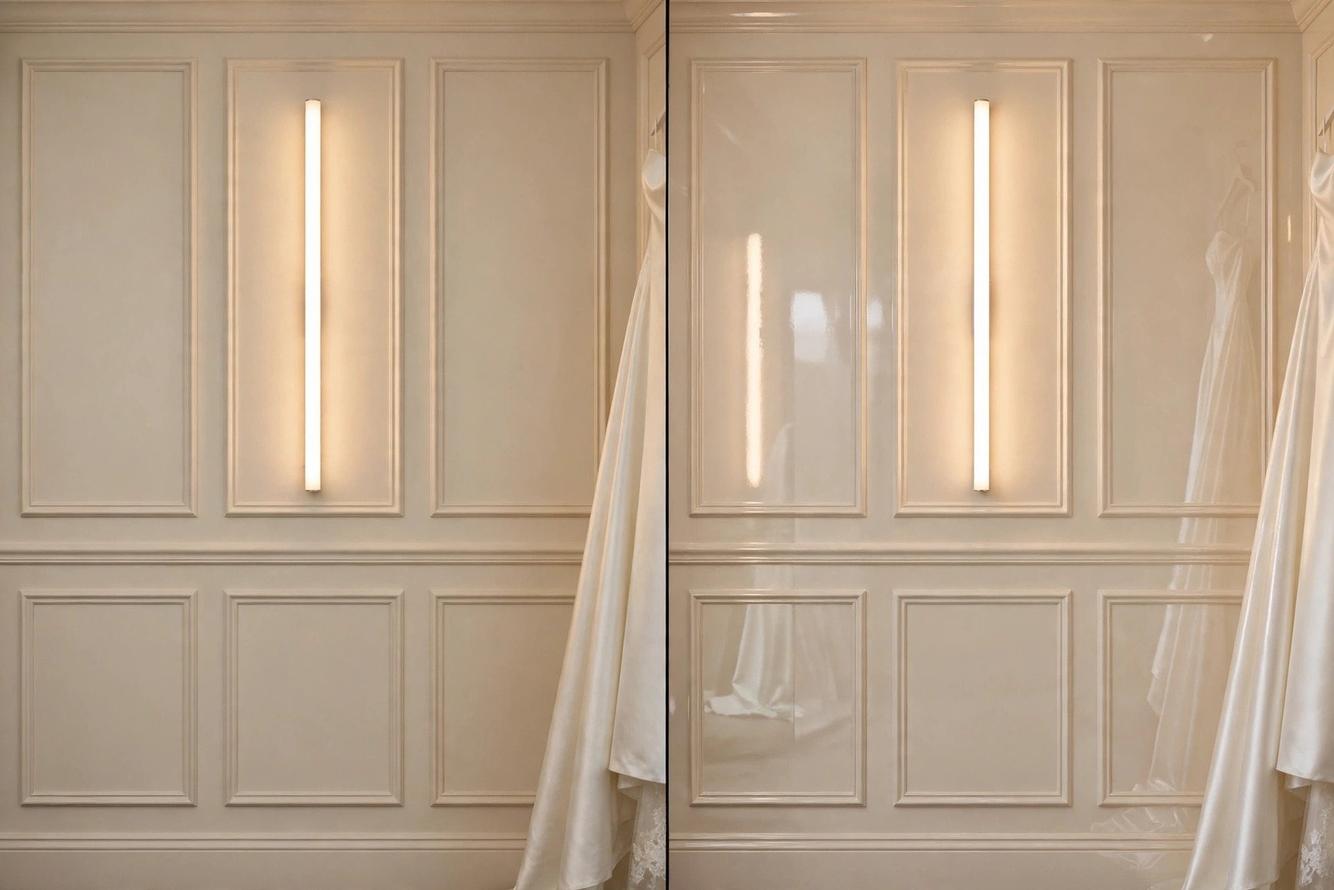
03 · THE POWER OF THE FINISH
It's All In The Finish.
Same wall. Same light.
01
Mirror-gloss walls
Paneled walls finished to a deep, reflective gloss.
02
Doors & trim
Coordinated high-gloss doors and trim work.
03
Feature surfaces
A signature wall or architectural detail.
04
Custom combinations
Finishes chosen to suit the boutique's interior.
CONVENTIONAL MATTE
IVORY MIRROR-GLOSS
Every surface is different — the right finish begins with an assessment of the substrate, the lighting, and how the room is used.
GREATLAKES PAINTING & RENOVATION
Conceptual Visualization

Slide 4
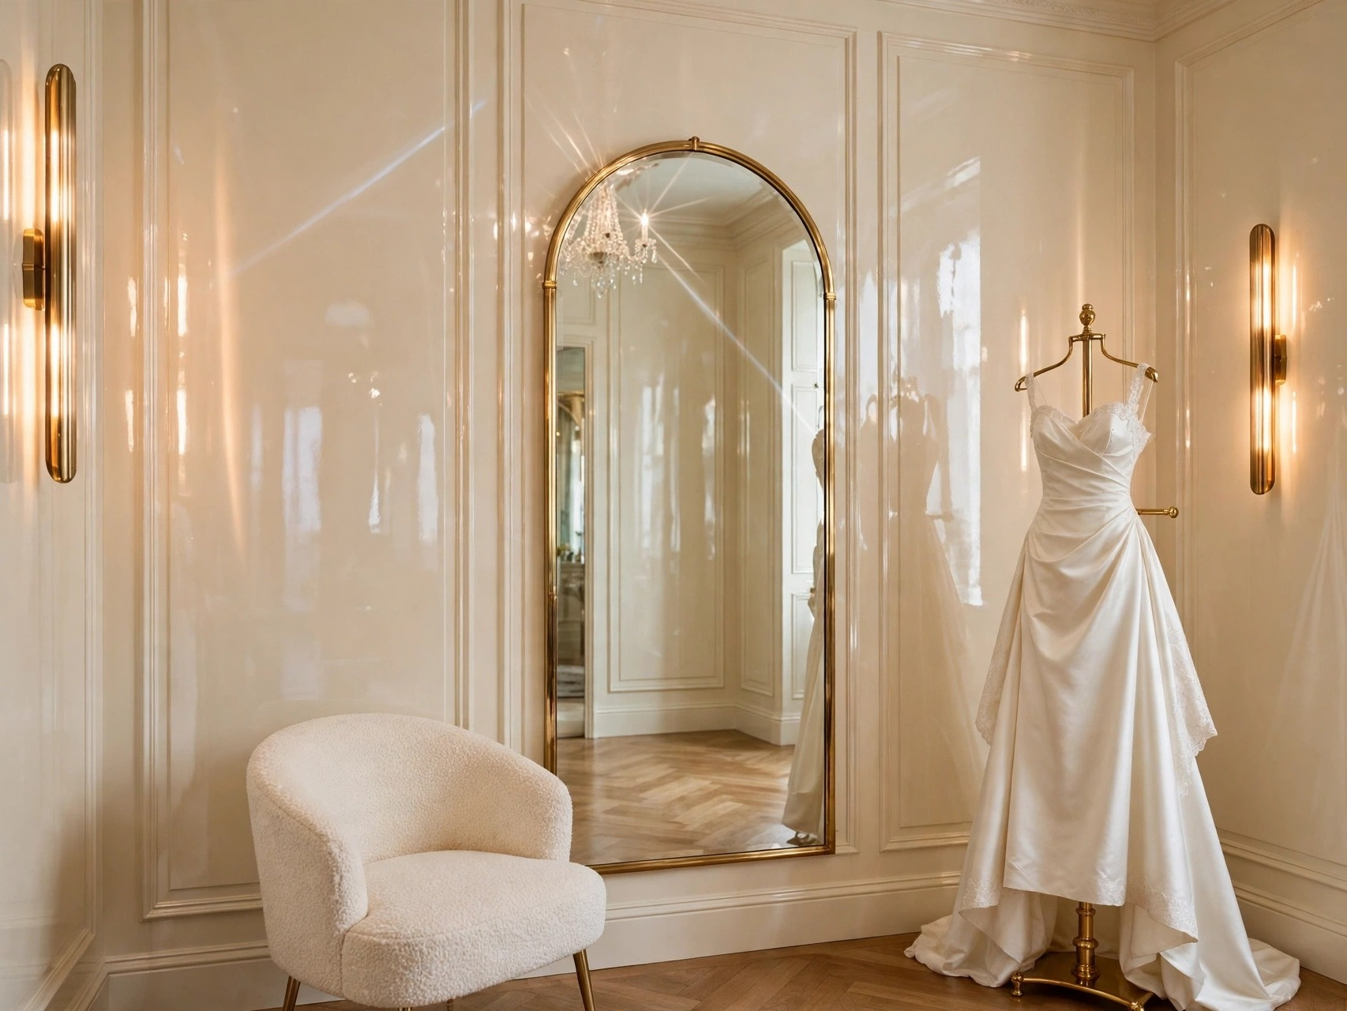

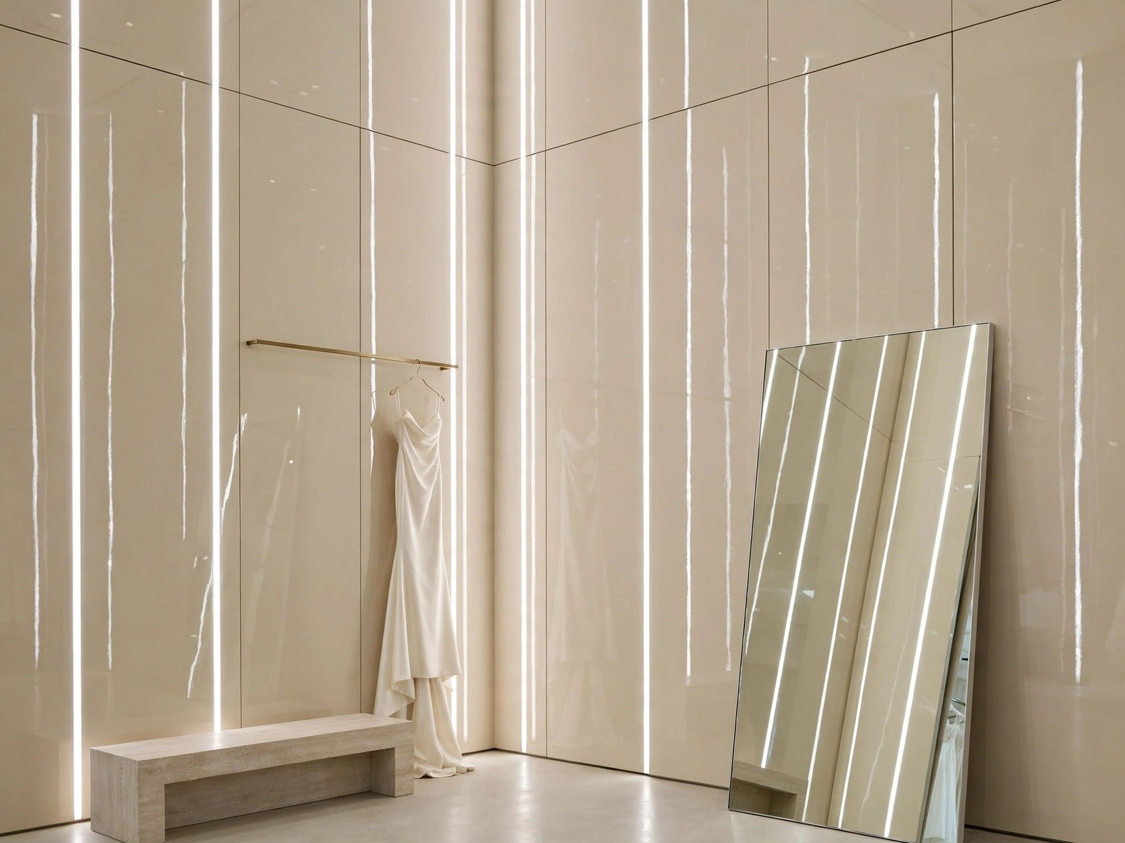
04 · DESIGNED AROUND YOUR BOUTIQUE
Your Space. Reimagined.
Three directions, one finish — each adapted to the character of the shop. Design concepts, not completed projects.
I · The Classic Boutique
II · The Signature Suite
III · The Modern Salon
Arched mirrors, warm brass, timeless paneling — gloss that belongs to the room.
A single fitting suite finished end-to-end: gloss walls, vertical light, the full moment.
Full-height panels and recessed light channels — calm, minimal, unmistakably premium.
The goal is never to make every boutique look the same — it is to complement the interior and the brand already there.
GREATLAKES PAINTING & RENOVATION
Conceptual Visualization

Slide 5
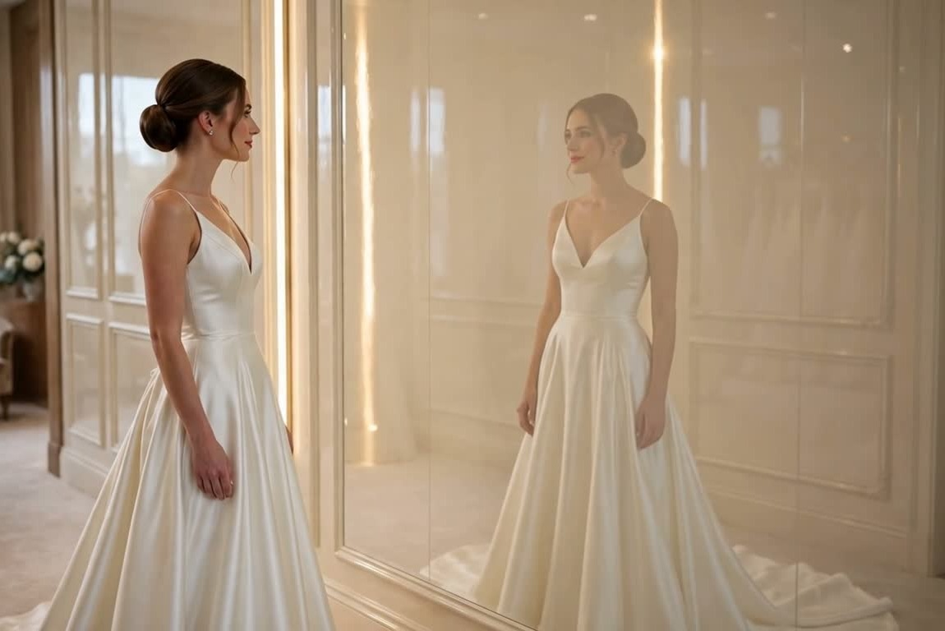
05 · THE CRAFTSMANSHIP BEHIND THE LOOK
Exceptional Finishes Begin Before The First Coat.
Skilled architectural finishing is a process, not a product — and most of it happens before any finish coat touches the wall.
01
Evaluate first
Surfaces, lighting, and use are assessed before anything is promised.
02
Prepare meticulously
Filling, sanding, and smoothing to a flawless substrate.
03
Prime & select
The appropriate primer and coating system for the surface.
04
Apply professionally
Controlled technique for a consistent, deep gloss.
05
Protect the boutique
Furnishings and surrounding finishes protected throughout.
06
Coordinate the room
Finish, lighting, and architecture considered together.
High gloss is honest: under reflected light, every imperfection shows. That is exactly why the preparation matters more than the paint.
GREATLAKES PAINTING & RENOVATION
Conceptual Visualization

Slide 6
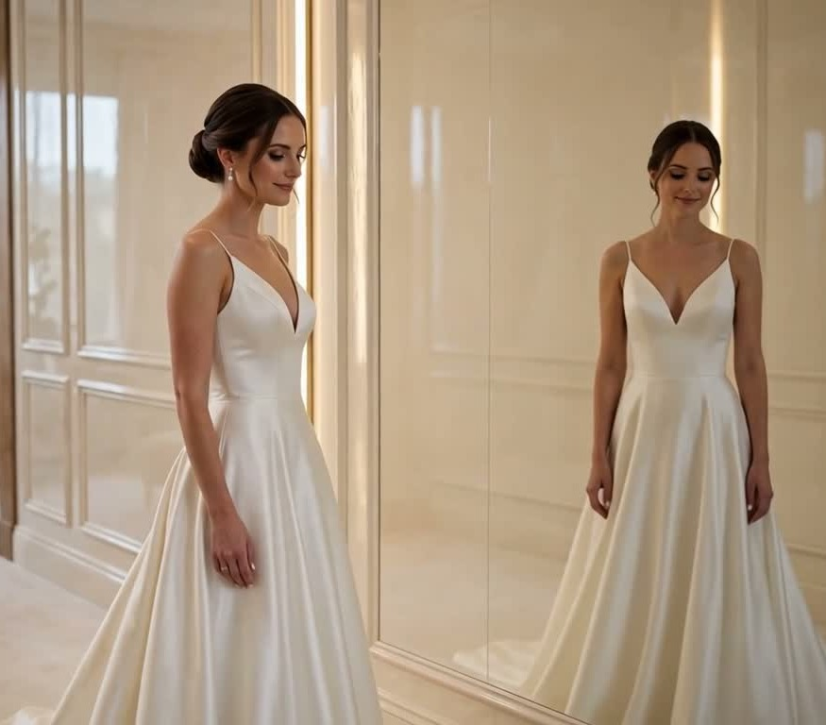

GREATLAKES
PAINTING & RENOVATION
Let's Make Your Fitting Rooms Unforgettable.
Let's explore what a beautifully executed high-gloss finish could look like in your boutique — starting with a complimentary conversation.
LET'S TALK ABOUT YOUR SPACE
Ben Washington · Owner · Columbus, Ohio
Call or text 586-318-0512
Email greatlakespaintingrenovation@gmail.com
Visit greatlakespaintingandrenovation.com
Scan to visit
our website
CONCEPTUAL VISUALIZATION

